Slide 1

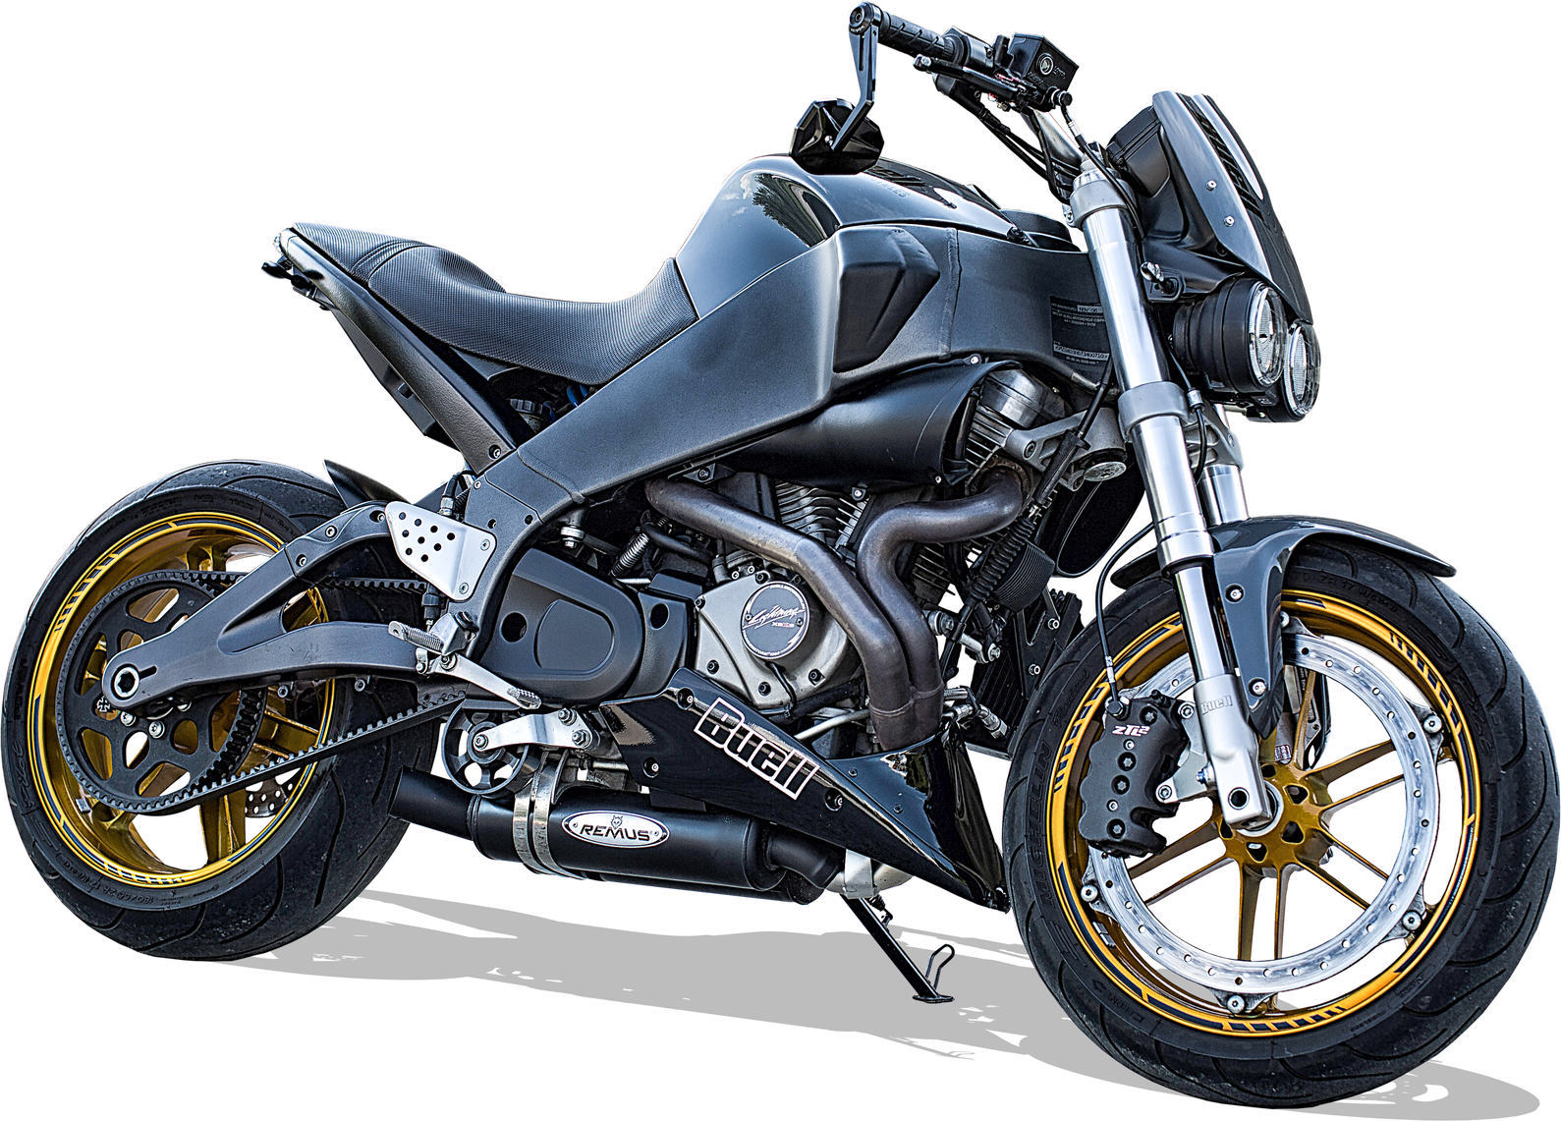


Bike dataset
Michea C.
Julian C.
Andrea M.

Slide 2

Dataset
Planned
End
First Dataset
from Kaggle, scraped from Bikez.com
38'000 rows, 99 columns
Planned Dataset
Accidents involving bikes
02

Slide 3
Dataset
Planned
End
What each row represents?
Each row corresponds to one motorcycle record and carries all of its attributes:
Identity & Classification
Model, Year, Category, Comments, Modifications
Performance & Dynamics
Power (HP/kW), Torque, 0–100 km/h, Top speed, ecc.
Engine & Drivetrain
Engine type, Fuel system/control, Cooling, Gearbox/Transmission
Economy, Emissions & Features
Fuel consumption, Greenhouse gases, Fuel capacity, ecc.
03

Slide 4
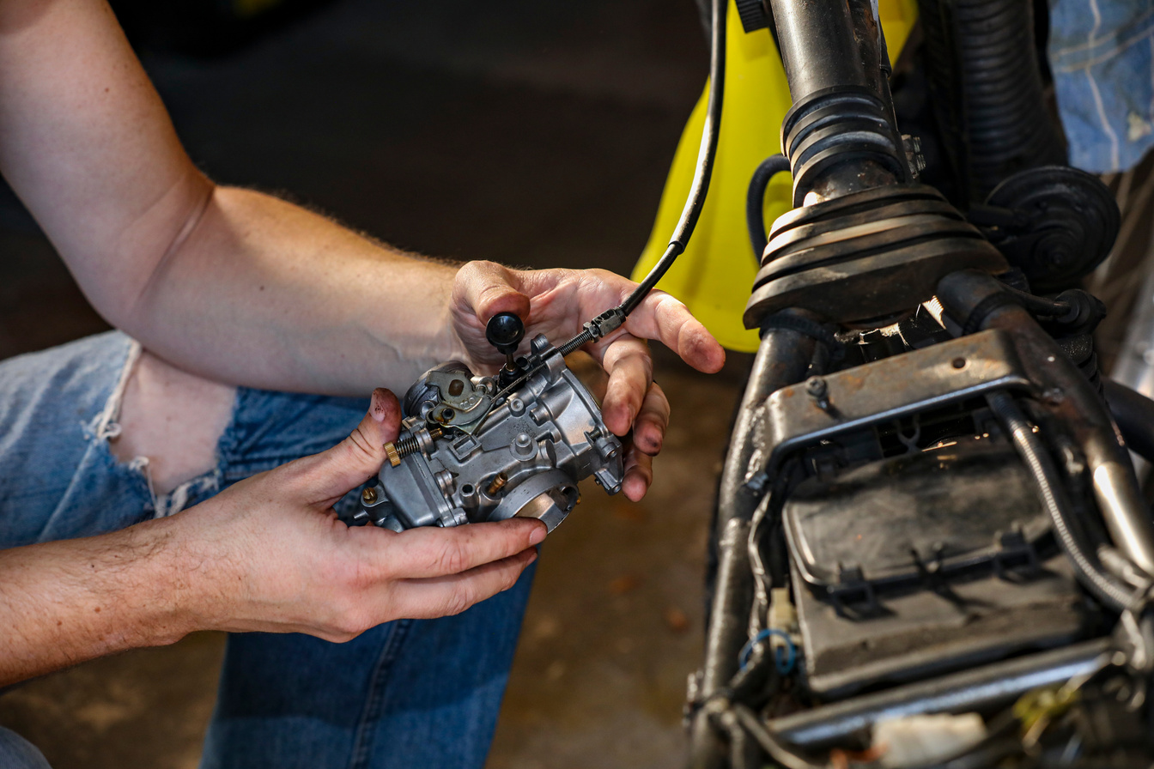



Dataset
Planned
End
Planned analysis
Relation between cost and: CV, brand, type
Relation between CV and fatalities
Relation between Bike brands and accidents
Other analysis
04

